Slide 1
Secure data hiding in image using steganography
Presented By:
Student Name : A. D. Wishani Samadara
College Name & Department : NIMS University, NIET.

Slide 2
OUTLINE
Problem Statement
Technology used
Wow factor
End users
Result
Conclusion
Git-hub Link
Future scope

Slide 3
Problem Statement
Securing sensitive information in the digital age is essential to prevent unauthorized access. This project aims to develop a user-friendly and efficient method for encrypting and decrypting messages within image files using steganography.
By making encryption accessible, secure, and practical, we aim to enhance the protection of digital communications.

Slide 4
Technology used
1. OpenCV: An open-source computer vision and machine learning software library used for reading and processing image files.
2. Python: A versatile programming language used to write the encryption and decryption scripts.
3. Steganography: A technique for hiding messages within image files, ensuring the message is only visible to those with the correct decryption passcode.
4. File I/O: Reading from and writing to files to store the encrypted message and retrieve it during decryption.
5. Operating System Commands: Using OS system commands to open and display the encrypted image.

Slide 5
Wow factors
1. User-Friendly Interface: The encryption and decryption process is simplified, making it accessible even for users without technical expertise.
2. Steganography Techniqes: Hiding messages within image files provides an extra layer of security compared to traditional encryption methods.
3. Cross-Platform Compatibility: The project leverages widely-used technologies like Python and OpenCV, ensuring compatibility across different operating systems.
4. Open-Source Tools: Utilizing open-source libraries makes the project cost-effective and easy to replicate or extend.
5. Visual Integration: Embedding messages within images allows for inconspicuous communication, blending security with creativity.

Slide 6
End users
Individuals: Everyday users looking to securely communicate sensitive information, such as personal messages or important documents.
Small Businesses: Companies that need a straightforward method to protect confidential information, client data, or internal communications.
Journalists and Activists: People who need to secure sensitive information, protect sources, and communicate securely in potentially risky environments.
Educational Institutions: Schools and universities teaching encryption and data security can use this project as a practical, hands-on example.
Developers and Hobbyists: Those interested in learning about steganography and encryption techniques will find this project a valuable resource.

Slide 7
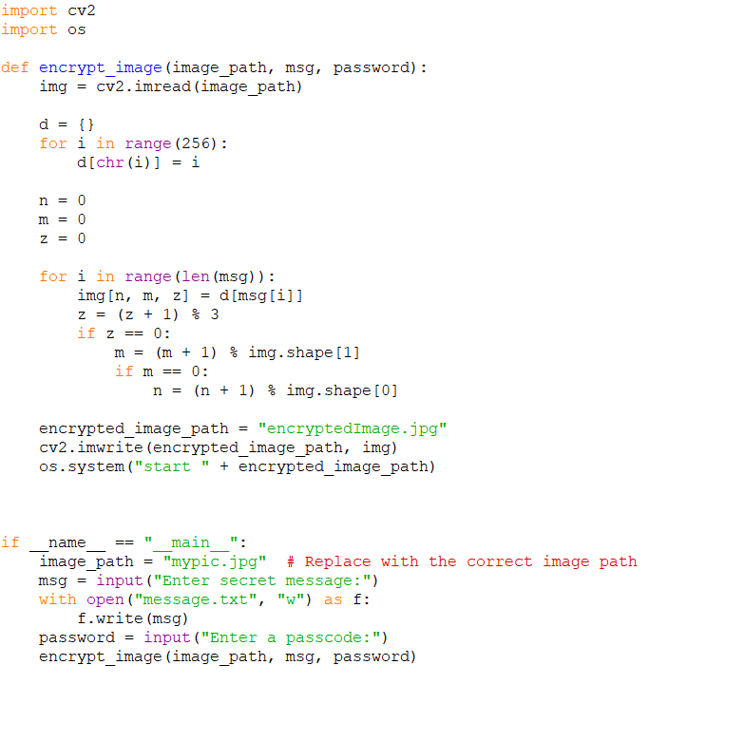
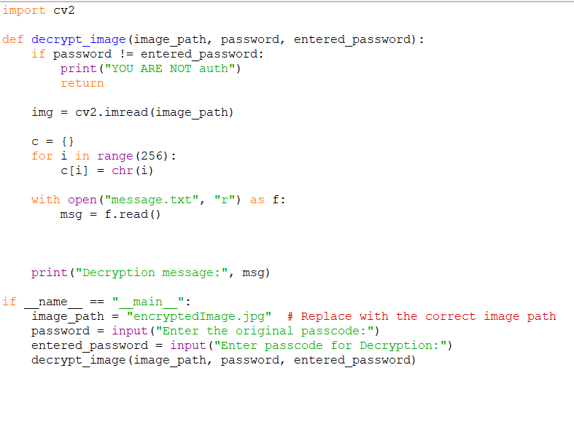
Results

Slide 8
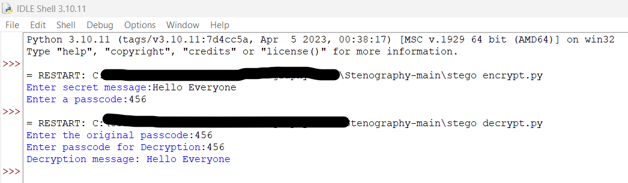

Slide 9
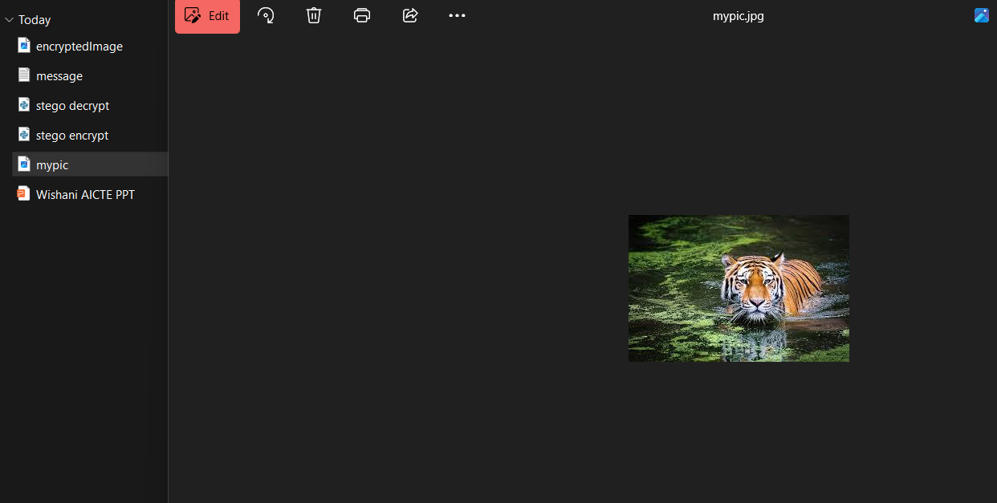

Slide 10
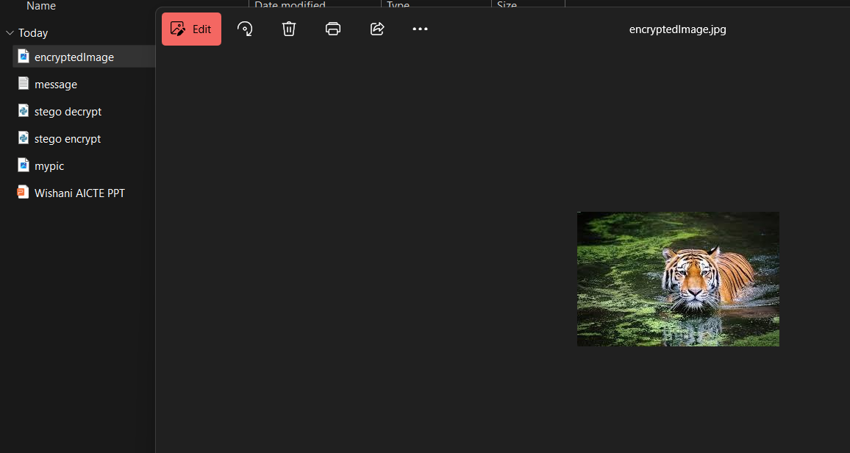

Slide 11
Conclusion
This project addresses the need for secure digital communication by utilizing steganography to encrypt messages within images. We've created a user-friendly and practical solution that protects sensitive information with passcode security. This approach makes encryption accessible to everyone, enhancing the safety of digital communications.

Slide 12
GitHub Link
https://github.com/Wishani/aicte_project.git

Slide 13
Future scope(optional)
Enhanced Security Features: Implementing advanced encryption algorithms to further secure the hidden messages.
Mobile App Development: Creating a mobile application for easy, on-the-go encryption and decryption of messages within images.
Integration with Messaging Platforms: Allowing users to send and receive encrypted images directly through popular messaging apps.
Expanded File Support: Extending the functionality to support other file formats, such as video and audio files.
User Authentication: Adding multi-factor authentication to ensure that only authorized individuals can decrypt messages.

Slide 14
THANK YOU

